Slide 1
Defensive Security Project
by: T34/\/\ 3
Notes:
Team 3 consists of Alec, Anthony, Bryan, Charles, Henry, and Xavier

Slide 2
Table of Contents
This document contains the following resources:
Monitoring Environment
Attack Analysis
Project Summary & Future Mitigations

Slide 3

Monitoring Environment: Splunk
‹#›

Slide 4
Scenario
VSI Network and Web-server experienced an attack, the results of which were captured and analyzed by our crack team of indentured security personnel.

Slide 5
Website Monitoring
‹#›

Slide 6
Website Monitoring
Monitor websites to detect downtime and performance problems. This app uses a modular input that can be setup easily (in 5 minutes or less).
Notes:
Nyan refers to the sound a cat makes rather than the name of the animal itself.

Slide 7
Website Monitoring
In the event of a website downage or interruption, our website monitoring will route alerts to splunk to allow us to respond and remediate. It also provides a dashboard with historical data allowing one to easily see when the site experiences heavy traffic.

Slide 8
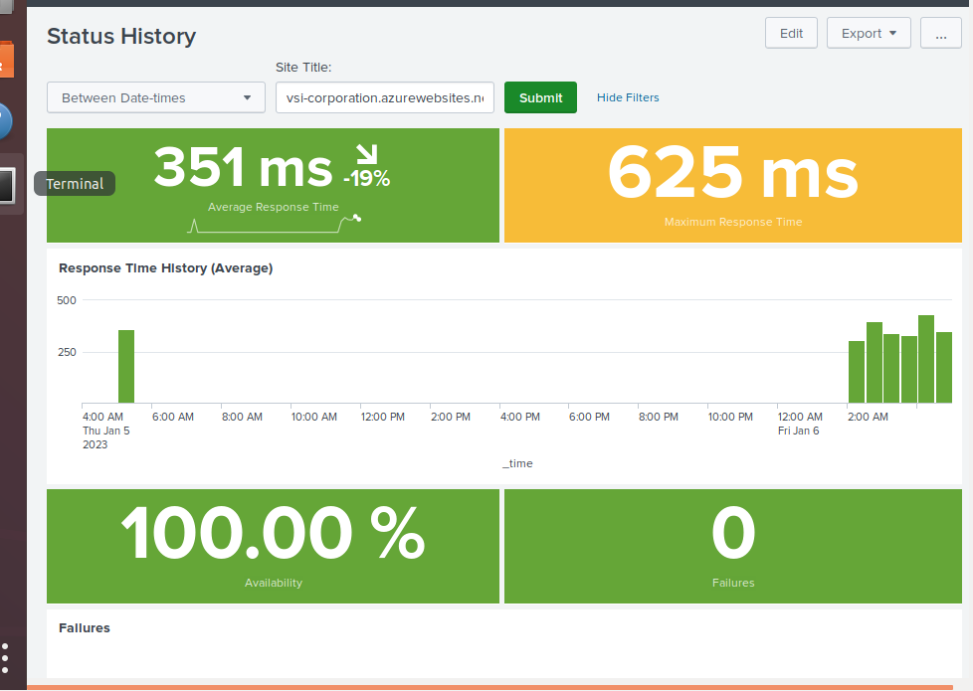
Website Monitoring
Notes:
Henry loves animals.

Slide 9
Logs Analyzed
Windows Logs
Apache Logs
1
2
Contains syslogs across network including failed logins , success logins, creations and deletions of user and computer accounts.
Contains Apache traffic, namely http traffic.This contains request type, and response code etc.

Slide 10
Windows Logs
‹#›

Slide 11
Reports—Windows
Designed the following Reports:
Report Name | Report Description
Severity Report | Identifies Severity and Severity ID of recorded events.
Signature/Signature_ID | Identifies Signature and Signature ID of recorded events, while also removing duplicate Signatures.
Signature/Signature_ID Report | Simply identifies the Signature ID of each Signature.
Status Report | Shows the Status of recorded events. Shows count and percentage of each Status.

Slide 12
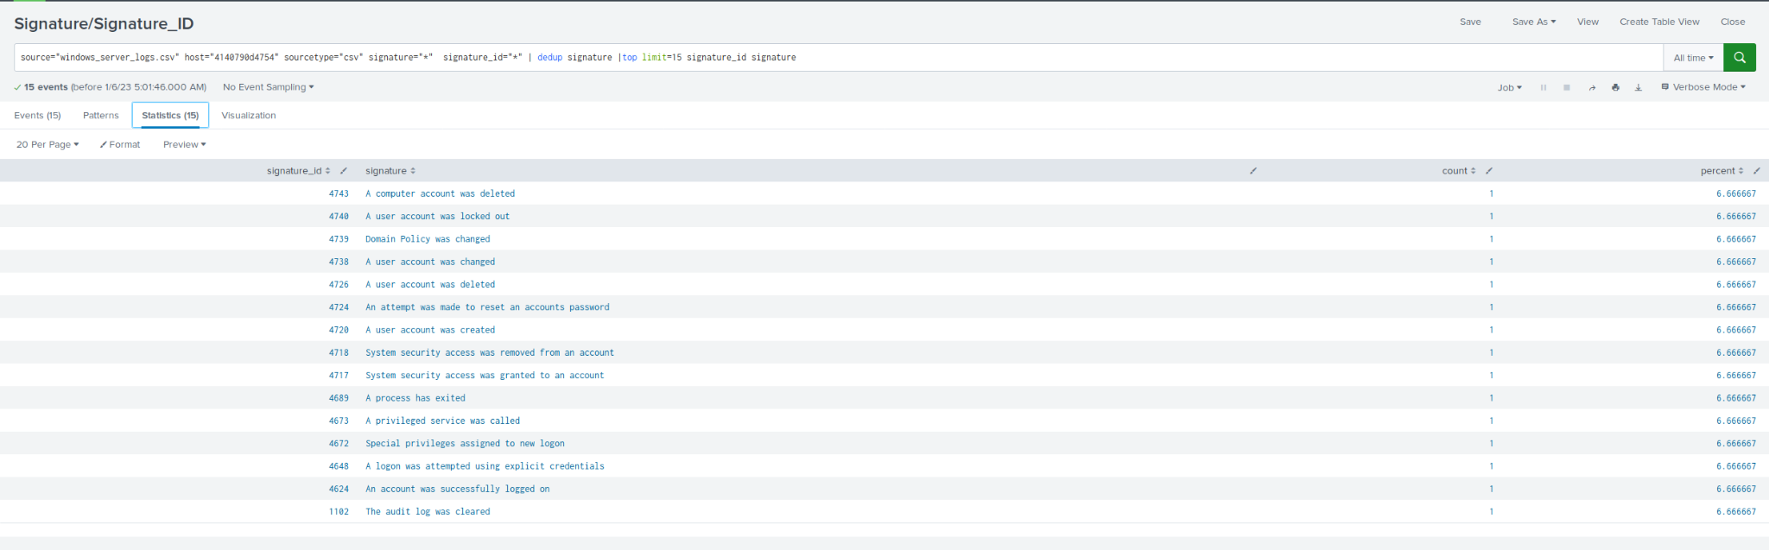
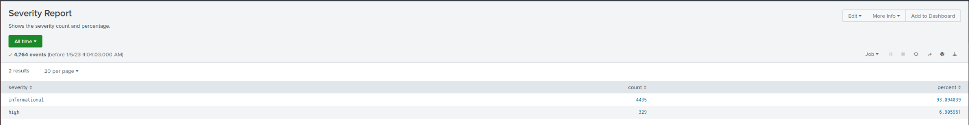
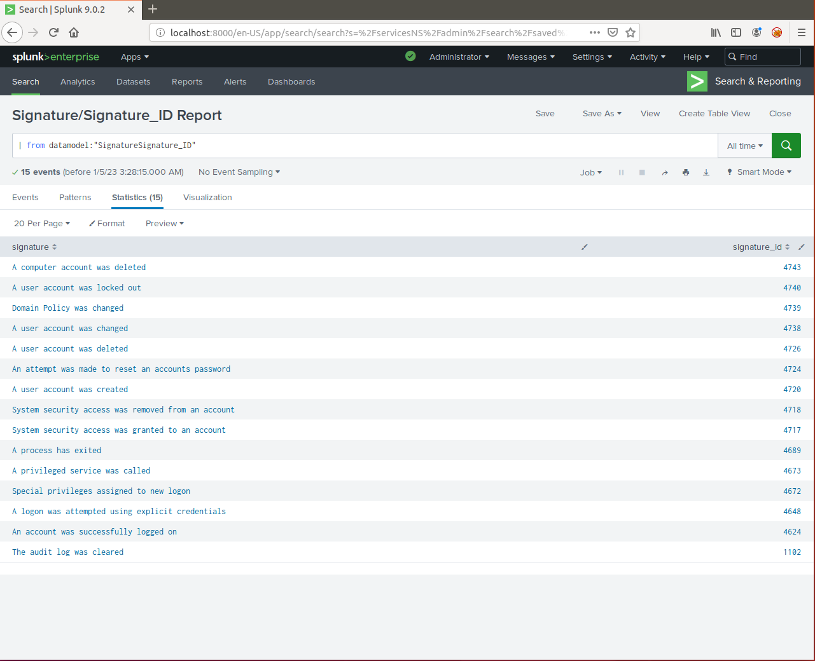
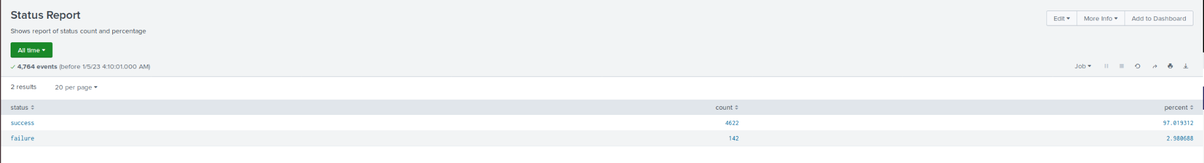
Images of Reports—Windows
Report Image
Report Image
Report Image
Report Image

Slide 13
Alerts—Windows
Designed the following alerts:
Alert Name | Alert Description | Alert Baseline | Alert Threshold
Login Failure | Alert for more than average login failures in an hour. | 7-11 logins failures an hour | 15 login failures an hour
JUSTIFICATION: The baseline over 3 days of data was about 7-11 average attempts per hour. We used 15 as a threshold, as receiving an alert helps to better detect potential brute force attacks early, as 11 attempts was the max of the baseline date.

Slide 14
Alerts—Windows
Designed the following alerts:
Alert Name | Alert Description | Alert Baseline | Alert Threshold
Successful Login Alert | Alerts when Successful Logins are much higher than average. | <= 22 | > 28
JUSTIFICATION: A baseline of <22 was used, as 22 was the max over 3 days. We anticipate a small fluctuation of successful logins, which led us to a threshold of >28 to send an alert, as this seems to be a larger than anticipated successful login amount was done.

Slide 15
Alerts—Windows
Designed the following alerts:
Alert Name | Alert Description | Alert Baseline | Alert Threshold
User Account Deleted Alert | User Account Deleted threshold met. | <= 22 | > 28
JUSTIFICATION: Baseline of <22 was found to be the highest value for each hour. As such, a small allowance of fluctuation was allowed to prevent false alerts. As such, a threshold of >28 was used to help alert of potentially concerning account deletions.

Slide 16
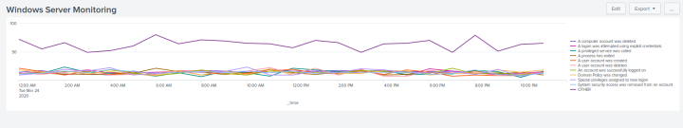
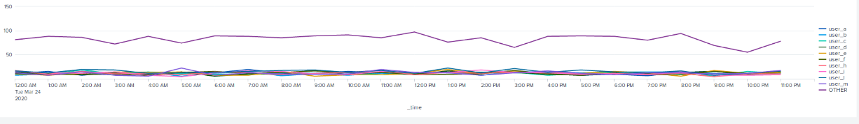
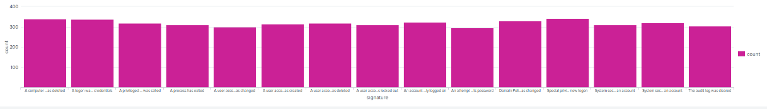
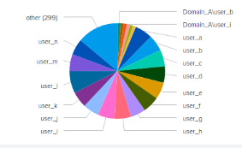
Dashboards—Windows
1
2
Place image here
Place image here
3
4
Place image here
Place image here
Notes:
1)Signatures over time 2)Different “user” values 3)Count of different signatures 4) Count of different users

Slide 17
Apache Logs
‹#›

Slide 18
Reports—Apache
Designed the following reports:
Report Name | Report Description
HTTP Methods | Count of HTTP methods
Top 10 Refer Domain | Count of refer domains
HTTP Response Code | Count of HTTP Response Codes

Slide 19
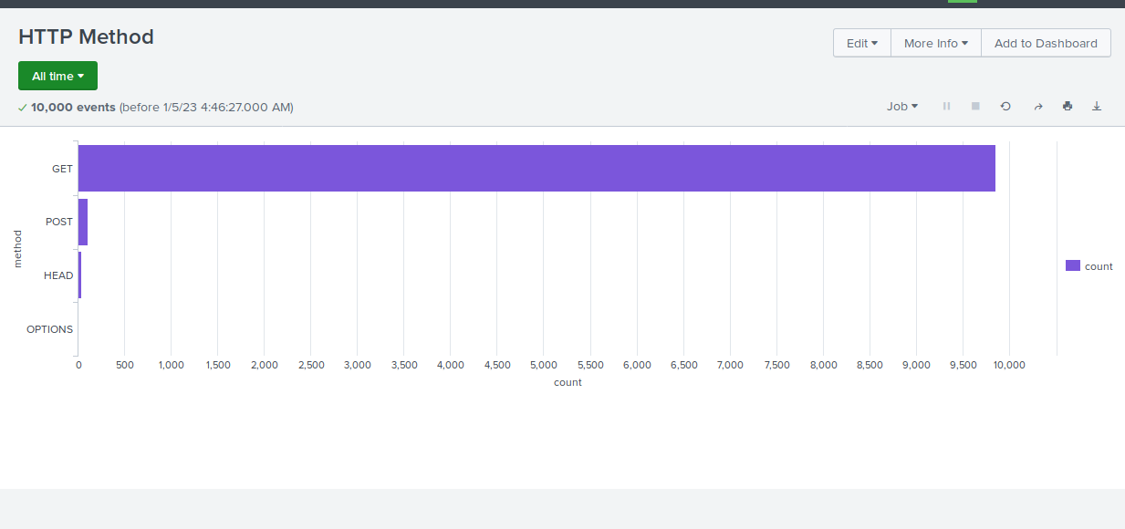
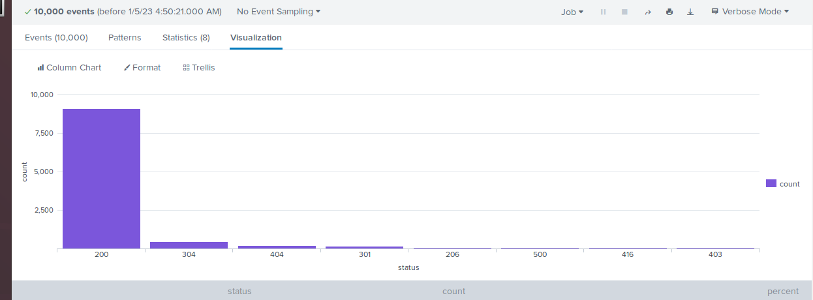
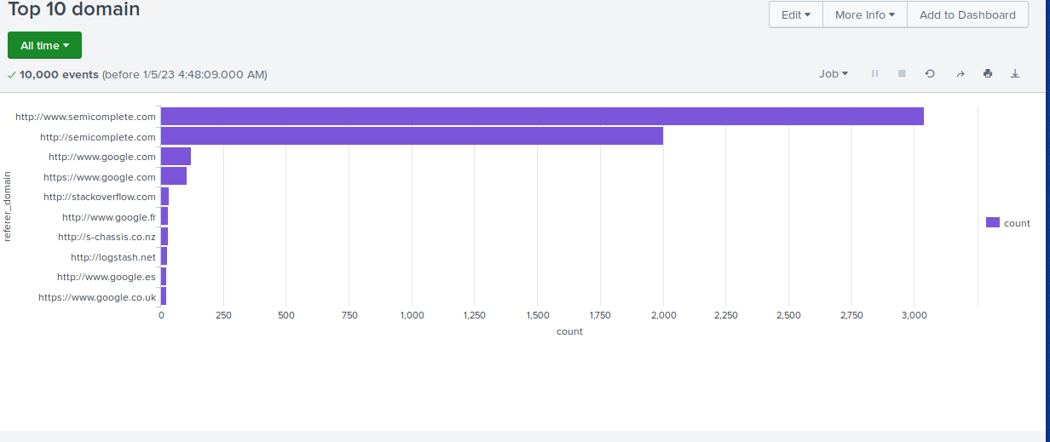
Images of Reports—Apache
HTTP Response Codes
Report Image
Report Image
Report Image

Slide 20
Alerts—Apache
Designed the following alerts:
Alert Name | Alert Description | Alert Baseline | Alert Threshold
Activity Outside the US | Hourly activity from outside the US | <120 | >140
Highest count in hour was 120 during normal use. So We chose an Alert Threshold to be a little higher than the highest known value.

Slide 21
Alerts—Apache
Designed the following alerts:
Alert Name | Alert Description | Alert Baseline | Alert Threshold
HTTP Post | Count of HTTP Post request per Hour | <8 | >10
Highest Post count was 7 in the normal logs. So We chose the Alert Threshold to an even 10.

Slide 22
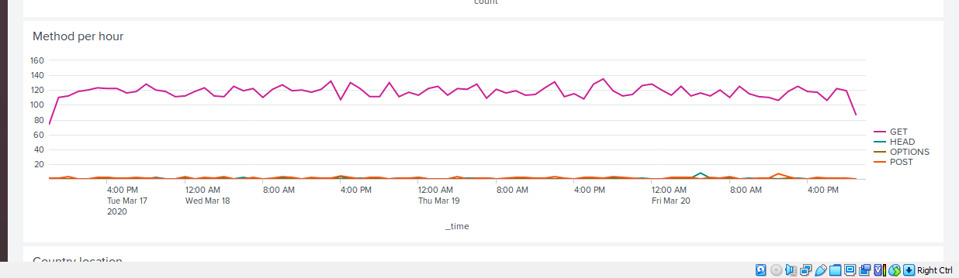
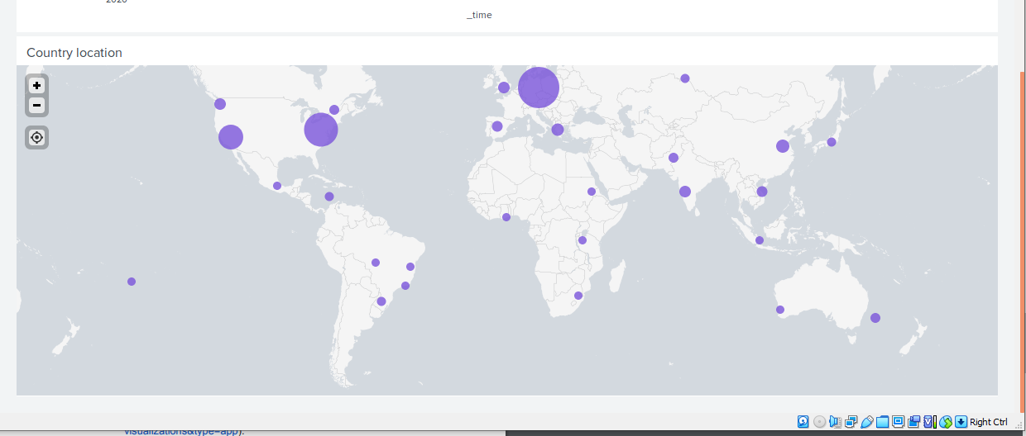
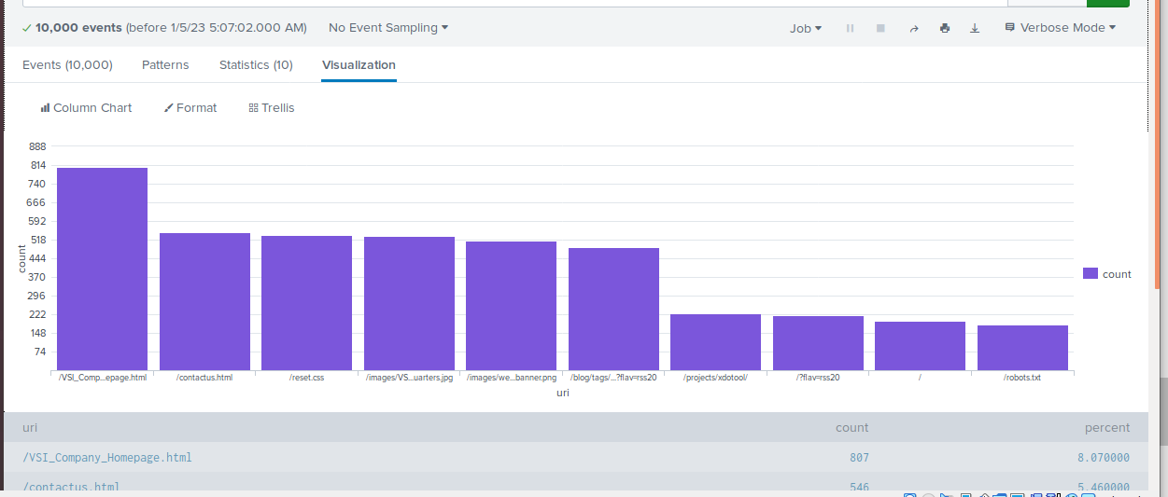
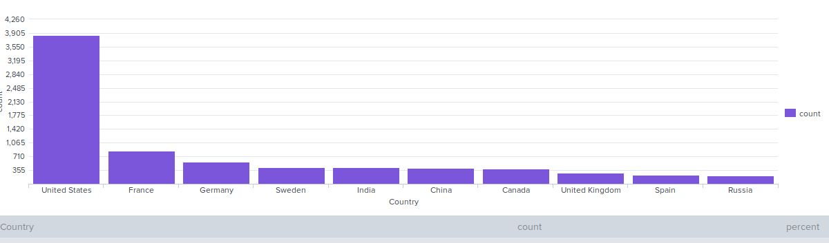
Dashboards—Apache
Method Per hour
Geolocation
Place image here
Place image here
URIs
Top 10 Country
Place image here
Place image here

Slide 23
Attack Analysis
‹#›

Slide 24
Attack Summary—Windows
Summarize your findings from your reports when analyzing the attack logs.
Compared with the baseline we created from the original logs the attack logs had several major differences.This included a large increase in high severity logs as well as logs related to successful logins, password resets, and account lock -outs. Also of note, there was a significant decrease in deleted accounts. Most nefarious activities centered around users User_a, User_k, User_j

Slide 25
Attack Summary—Windows
Summarize your findings from your alerts when analyzing the attack logs. Were the thresholds correct?
Alerts showed the increase successful logins and failed activities. Our threshold, which were generally set around 20% over the baseline were triggered in all cases except for deleted accounts, where the suspicious activity was a dearth in logs of this type. Most successful login were by User_j.

Slide 26
Attack Summary—Windows
Summarize your findings from your dashboards when analyzing the attack logs.
Our Dashboards showed a significant increase in alerts with lockout and password reset signatures. It also showed a large proportion of activity involving User_a and User_k.
Notes:
Henry loves animals.

Slide 27
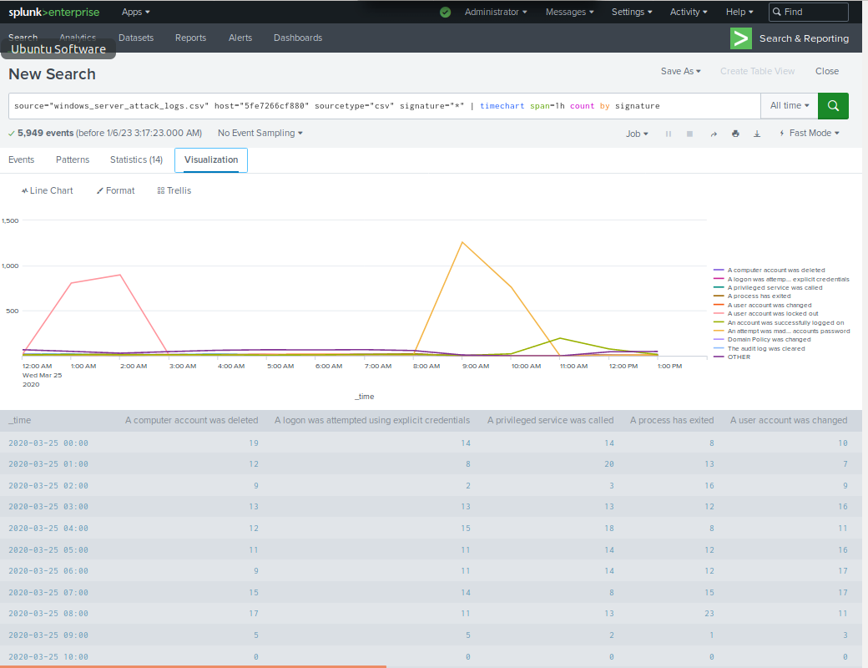
Screenshots of Attack Logs

Slide 28
Attack Summary—Apache
Summarize your findings from your reports when analyzing the attack logs.
We noticed a increase in HTTP method specifically POST. This also coincided with an increase in activity from outside the United States.

Slide 29
Attack Summary—Apache
Summarize your findings from your alerts when analyzing the attack logs. Were the thresholds correct?
We had two alerts set up to catch increases in HTTP method POST and access internationally. Both thresholds were low enough to catch this attack. Although the threshold for HTTP method POST could be too low compared to the count in the attack. Our baseline was 8 and threshold was set at 10. The count was magnitudes higher than the threshold. The threshold could be adjusted higher to prevent too many fail alarms.
Notes:
there were 2 alerts catching the increase in HTTP method post. the threshold was a possible a little to low but it still caught the attack and we would probably raise it to prevent false alarms

Slide 30
Attack Summary—Apache
Summarize your findings from your dashboards when analyzing the attack logs.
Our Dashboard report with a clustered map graph showed a significant increase in http traffic from the areas around Kiev and Kharkiv. Dashboards also show huge peaks in traffic from 7 to 9. Our URI dashboard also showed a large increase in the URI VSI_account_login.
Notes:
our Dashboard shows alot of traffic in Kiev and Kharkiv peaking from 7-9 the dashboard also showed increase URI VSI_account_login

Slide 31
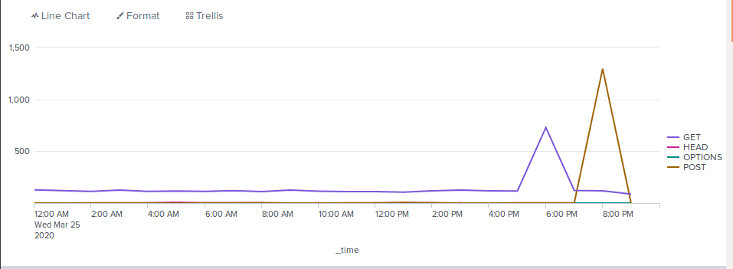
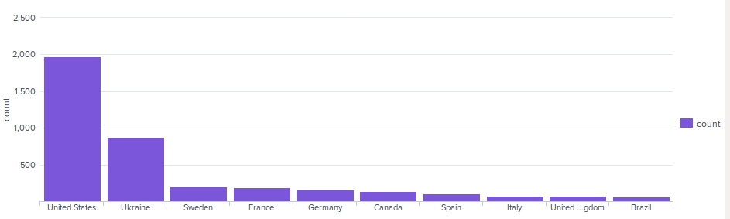
Screenshots of Attack Logs
Notes:
this is our screenshot of attacks logs starting around 5 and peaking at 8

Slide 32
Summary and Future Mitigations
‹#›

Slide 33
Project 3 Summary
What were your overall findings from the attack that took place?
There were a significant amount of attacks on various accounts from 3 suspicious threat actors. Methods included brute force and password resets. There were attacks coming from mostly European countries as well as US attacks from both coasts.
To protect VSI from future attacks, what future mitigations would you recommend?
I would make sure permissions are set correctly for each user and group. I also would have a limit on the amount of login attempts per minute or hour set to a lower amount while also utilizing MFA. Lastly I would only allow certain IP addresses and/or specific countries to connect to the network and use a trusted VPN to secure each connection.

